Slide 1
Evolution of Database Technology
1960s and earlier:
Data Collection and Database Creation
  Primitive file processing

Slide 2
Evolution of Database Technology
1970s - early 1980s:
Data Base Management Systems
  Hieratical and network database systems
  Relational database Systems
  Query languages: SQL
  Transactions, concurrency control and recovery.
  On-line transaction processing (OLTP)

Slide 3
Evolution of Database Technology
Mid -1980s - present:
  Advanced data models
    Extended relational, object-relational
  Advanced application-oriented DBMS
    spatial, scientific, engineering, temporal, multimedia, active, stream and sensor, knowledge-based

Slide 4
Evolution of Database Technology
Late 1980s-present
  Advanced Data Analysis
    Data warehouse and OLAP
    Data mining and knowledge discovery
    Advanced data mining appliations
    Data mining and socity
1990s-present:
  XML-based database systems
  Integration with information retrieval
  Data and information integreation

Slide 5
Evolution of Database Technology
Present – future:
  New generation of integrated data and information system.

Slide 6
What Is Data Mining?

Slide 7
What Is Data Mining?
Data mining refers to extracting or mining knowledge from large amounts of data.
Mining of gold from rocks or sand
Knowledge mining from data, knowledge extraction, data/pattern analysis, data archeology, and data dreding.
Knowledge Discovery from data, or KDD

Slide 8
Data Mining: A KDD Process
Knowledge
presentation
Pattern Evaluation
  Data mining: the core of knowledge discovery process.
Data Mining
Task-relevant Data
Data Warehouse
Selection
Transformation
Data Cleaning
Data Integration
Databases

Slide 9
Steps of a KDD Process
Data cleaning
Data integration
Data selection
Data transformation
Data mining
Pattern evaluation
Knowledge presentaion

Slide 10
Steps of a KDD Process
Learning the application domain:
  relevant prior knowledge and goals of application
Creating a target data set: data selection
Data cleaning and preprocessing
Data reduction and transformation:
  Find useful features, dimensionality/variable reduction, invariant representation.

Slide 11
Steps of a KDD Process
Choosing functions of data mining
  summarization, classification, regression, association, clustering.
Choosing the mining algorithms
Data mining: search for patterns of interest
Pattern evaluation and knowledge presentation
  visualization, transformation, removing redundant patterns, etc.
Use of discovered knowledge

Slide 12
Architecture of a Typical Data Mining System
Graphical user interface
Pattern evaluation
Data mining engine
Knowledge-base
Database or data warehouse server
Data cleaning & data integration
Filtering
Data
Warehouse
Databases

Slide 13
Data Mining and Business Intelligence
Increasing potential
to support
business decisions
Making
Decisions
End User
Data Presentation
Business
Analyst
Visualization Techniques
Data Mining
Data
Analyst
Information Discovery
Data Exploration
Statistical Analysis, Querying and Reporting
Data Warehouses / Data Marts
OLAP, MDA
DBA
Data Sources
Paper, Files, Information Providers, Database Systems, OLTP

Slide 14
Data Mining: On What Kind of Data?

Slide 15
Answer : On any kind of data.

Slide 16
Data Mining: On What Kind of Data?
Relational databases
Data warehouses
Transactional databases

Slide 17
Data Mining: On What Kind of Data?
Advanced DB and information repositories
  Object-oriented and object-relational databases
  Spatial databases
  Time-series data and temporal data
  Text databases and multimedia databases
  Heterogeneous and legacy databases
  WWW

Slide 18
Data Mining Functionalities -What kind of patterns can be mined?

Slide 19
Data mining tasks generally classified into two categories.
Descriptive :It characterize the general properties of data in the database.
Predictive :It performs inference(interpretation) on the current data in order to make predictions.

Slide 20
Data Mining Functionalities
Concept description: Characterization and discrimination
  Data can be associated with classes or concepts
  Ex. AllElectronics store classes of items for sale include computer and printers.
  Description of class or concept is called class/concept description.
  Data characterization : summarization of general features
  of target class of data.
  Data discrimination : comparison of target class with one or more contrasting classes.

Slide 21
Data Mining Functionalities
Association Analysis
  Multi-dimensional vs. single-dimensional association
  age(X, “20..29”) ^ income(X, “20..29K”) => buys(X, “PC”) [support = 2%, confidence = 60%]
  contains(T, “computer”) => contains(x, “software”) [support=1%, confidence=75%]

Slide 22
Data Mining Functionalities
Classification and Prediction
  Finding models (functions) that describe and distinguish data classes or concepts for predict the class whose label is unknown
  E.g., classify countries based on climate, or classify cars based on gas mileage
  Models: decision-tree, classification rules (if-then), neural network
  Prediction: Predict some unknown or missing numerical values

Slide 23
Data Mining Functionalities
Cluster analysis
  Analyze class-labeled data objects, clustering analyze data objects without consulting a known class label.
  Clustering based on the principle: maximizing the intra-class similarity and minimizing the interclass similarity

Slide 24
Data Mining Functionalities
Outlier analysis
  Outlier: a data object that does not comply(fulfill) with the general behavior of the model of the data
  It can be considered as noise or exception but is quite useful in fraud detection, rare events analysis
Trend and evolution analysis
  Trend and deviation: regression analysis
  Sequential pattern mining, periodicity analysis
  Similarity-based analysis

Slide 25
Data Mining: Classification Schemes

Slide 26
Data Mining: Confluence of Multiple Disciplines
Database
Technology
Statistics
Information
Science
Data Mining
MachineLearning
Visualization
Other
Disciplines

Slide 27
Data Mining systems: Classification Schemes
General functionality
  Descriptive data mining
  Predictive data mining
Data mining various criteria's:
  Kinds of databases to be mined
  Kinds of knowledge to be discovered
  Kinds of techniques utilized
  Kinds of applications adopted

Slide 28
Data Mining: Classification Schemes
Databases to be mined
  Relational, transactional, object-oriented, object-relational, active, spatial, time-series, text, multi-media, heterogeneous, legacy, WWW, etc.
Knowledge to be mined
  Characterization, discrimination, association, classification, clustering, trend, deviation and outlier analysis, etc.
  Multiple/integrated functions and mining at multiple levels

Slide 29
Data Mining: Classification Schemes
Techniques utilized
  Database-oriented, data warehouse (OLAP), machine learning, statistics, visualization, neural network, etc.
Applications adopted
  Retail, telecommunication, banking, fraud analysis, DNA mining, stock market

Slide 30
Major Issues in Data Mining

Slide 31
Major Issues in Data Mining
1. Mining methodology and user interaction issues
  Mining different kinds of knowledge in databases
  Interactive mining of knowledge at multiple levels of abstraction
  Incorporation of background knowledge
  Data mining query languages and ad-hoc data mining
  Expression and visualization of data mining results
  Handling noise and incomplete data
  Pattern evaluation: the interestingness problem

Slide 32
Major Issues in Data Mining
2. Performance issues
  Efficiency and scalability of data mining algorithms
  Parallel, distributed and incremental mining methods

Slide 33
Major Issues in Data Mining
3. Issues relating to the diversity of data types
  Handling relational(simple) and complex types of data.
  Mining information from heterogeneous databases and global information systems (WWW)

Slide 34
What is Data Warehouse?

Slide 35
What is Data Warehouse?
Defined in many different ways
  A decision support database that is maintained separately from the organization’s operational database
  Support information processing by providing a solid platform of consolidated, historical data for analysis.
“A data warehouse is a subject-oriented, integrated, time-variant, and nonvolatile collection of data in support of management’s decision-making process.”—W. H. Inmon
Data warehousing:
  The process of constructing and using data warehouses

Slide 36
Data Warehouse—Subject-Oriented
Organized around major subjects, such as customer, product, sales.
Focusing on the modeling and analysis of data for decision makers, not on daily operations or transaction processing.
Provide a simple and concise view around particular subject issues by excluding data that are not useful in the decision support process.

Slide 37
Data Warehouse—Integrated
Constructed by integrating multiple, heterogeneous data sources
  relational databases, flat files, on-line transaction records
Data cleaning and data integration techniques are applied.
  Ensure consistency in naming conventions, encoding structures, attribute measures, etc. among different data sources
    E.g., Hotel price: currency, tax, breakfast covered, etc.
  When data is moved to the warehouse, it is converted.

Slide 38
Data Warehouse—Time Variant
The time horizon for the data warehouse is significantly longer than that of operational systems.
  Operational database: current value data.
  Data warehouse data: provide information from a historical perspective (e.g., past 5-10 years)
Every key structure in the data warehouse
  Contains an element of time, explicitly or implicitly
  But the key of operational data may or may not contain “time element”.

Slide 39
Data Warehouse—Non-Volatile
A physically separate store of data transformed from the operational environment.
Operational update of data does not occur in the data warehouse environment.
  Does not require transaction processing, recovery, and concurrency control mechanisms
  Requires only two operations in data accessing:
    initial loading of data and access of data.

Slide 40
Data Warehouse vs. Operational DBMS
Distinct features (OLTP vs. OLAP):
  User and system orientation: customer vs. market
  Data contents: current, detailed vs. historical, consolidated
  Database design: ER + application vs. star + subject
  View: current, local vs. evolutionary, integrated
  Access patterns: update vs. read-only but complex queries

Slide 41
Data Warehouse vs. Operational DBMS
OLTP (on-line transaction processing)
  Major task of traditional relational DBMS
  Day-to-day operations: purchasing, inventory, banking, manufacturing, payroll, registration, accounting, etc.
OLAP (on-line analytical processing)
  Major task of data warehouse system
  Data analysis and decision making

Slide 42
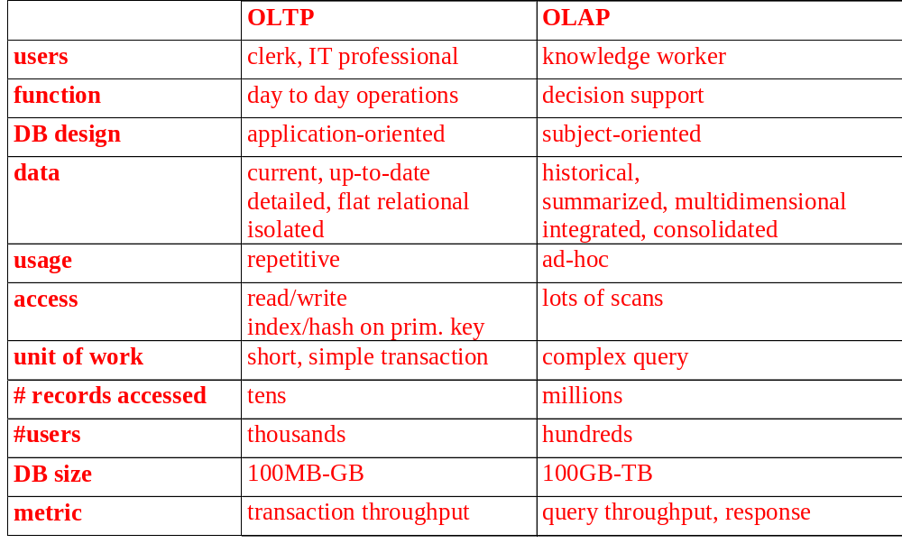
OLTP vs. OLAP

Slide 43
Why Separate Data Warehouse?
High performance for both systems
  DBMS— tuned for OLTP: access methods, indexing, concurrency control, recovery
  Warehouse—tuned for OLAP: complex OLAP queries, multidimensional view, consolidation.

Slide 44
Why Separate Data Warehouse?
Different functions and different data:
  missing data: Decision support requires historical data which operational DBs do not typically maintain
  data consolidation: DS requires consolidation (aggregation, summarization) of data from heterogeneous sources
  data quality: different sources typically use inconsistent data representations, codes and formats which have to be reconciled

Slide 45
OLAP Operations in MDM
Roll up (drill-up): summarize data
  by climbing up hierarchy or by dimension reduction
Roll down (Drill down): reverse of roll-up
  from higher level summary to lower level summary or detailed data, or introducing new dimensions
Slice and dice:
  project and select

Slide 46
OLAP Operations
Pivot (rotate):
  reorient the cube, visualization, 3D to series of 2D planes.
Other operations
  drill across: involving (across) more than one fact table
  drill through: through the bottom level of the cube to its back-end relational tables (using SQL)

Slide 47
Data warehouse architecture

Slide 48
Steps for the Design and Construction of Data Warehouse
The design of a data warehouse: a business analysis framework
The process of data warehouse design
A three-tier data ware house architecture

Slide 49
Design of a Data Warehouse: A Business Analysis Framework
Four views regarding the design of a data warehouse
  Top-down view
    allows selection of the relevant information necessary for the data warehouse

Slide 50
Design of a Data Warehouse: A Business Analysis Framework
  Data warehouse view
    consists of fact tables and dimension tables
  Data source view
    exposes the information being captured, stored, and managed by operational systems
  Business query view
    sees the perspectives

Slide 51
Data Warehouse Design Process
Top-down, bottom-up approaches or a combination of both
  Top-down: Starts with overall design and planning (mature)
  Bottom-up: Starts with experiments and prototypes (rapid)
From software engineering point of view
  Waterfall: structured and systematic analysis at each step before proceeding to the next
  Spiral: rapid generation of increasingly functional systems, short turn around time, quick turn around

Slide 52
Data Warehouse Design Process
Typical data warehouse design process
  Choose a business process to model, e.g., orders, invoices, etc.
  Choose the grain (atomic level of data) of the business process
  Choose the dimensions that will apply to each fact table record
  Choose the measure that will populate each fact table record

Slide 53
Multi-Tiered Architecture
Monitor
&
Integrator
OLAP Server
other
sources
Metadata
Analysis
Query
Reports
Data mining
Operational
DBs
Extract
Transform
Load
Refresh
Data
Warehouse
Serve
Data Marts
Data Sources
Data Storage
OLAP Engine
Front-End Tools

Slide 54
Metadata Repository
Meta data is the data defining warehouse objects. It has the following kinds
  Description of the structure of the warehouse
    schema, view, dimensions, hierarchies, derived data defn, data mart locations and contents
  Operational meta-data
    data lineage (history of migrated data and transformation path), currency of data (active, archived, or purged), monitoring information (warehouse usage statistics, error reports, audit trails)
  The algorithms used for summarization
  The mapping from operational environment to the data warehouse
  Data related to system performance
    warehouse schema, view and derived data definitions
  Business data
    business terms and definitions, ownership of data, charging policies

Slide 55
Data Warehouse Back-End Tools and Utilities
Data extraction:
  get data from multiple, heterogeneous, and external sources
Data cleaning:
  detect errors in the data and rectify them when possible
Data transformation:
  convert data from legacy or host format to warehouse format
Load:
  sort, summarize, consolidate, compute views, check integrity, and build indices and partitions
Refresh
  propagate the updates from the data sources to the warehouse

Slide 56
Three Data Warehouse Models
Enterprise warehouse
  collects all of the information about subjects spanning the entire organization
Data Mart
  a subset of corporate-wide data that is of value to a specific groups of users. Its scope is confined to specific, selected groups, such as marketing data mart
    Independent vs. dependent (directly from warehouse) data mart
Virtual warehouse
  A set of views over operational databases
  Only some of the possible summary views may be materialized

Slide 57
Data Warehouse Development: A Recommended Approach
Multi-Tier Data Warehouse
Distributed Data Marts
Enterprise Data Warehouse
Data Mart
Data Mart
Model refinement
Model refinement
Define a high-level corporate data model

Slide 58
Types of OLAP Servers
Relational OLAP (ROLAP)
  Use relational or extended-relational DBMS to store and manage warehouse data and OLAP middle ware to support missing pieces
  Include optimization of DBMS backend, implementation of aggregation navigation logic, and additional tools and services
  greater scalability
Multidimensional OLAP (MOLAP)
  Array-based multidimensional storage engine (sparse matrix techniques)
  fast indexing to pre-computed summarized data

Slide 59
Types of OLAP Servers
Hybrid OLAP (HOLAP)
  User flexibility, e.g., low level: relational, high-level: array
Specialized SQL servers
  specialized support for SQL queries over star/snowflake schemas

